Slide 1




JAHAZING
An IICT Lab’s Project for First Year Students

Slide 2
GROUP MEMBERS
Muhammad Ashhad Safwan- cs201081
Muhammad Saad Amin-cs201091
Muhammad Anas Shaikh-cs201079
Muhammad Hamza Siddiqui-cs201083

Slide 3
An overview
Our project is about an airline website
A user can view menu for the meals available during the flight, look out for the job, know our brief history and most importantly, can reserve tickets
User can navigate through different webpages with the tags given on the header

Slide 4
Number of Folders
There are 4 types of folders mentioned in the main folder
Images
HTML
CSS (Cascading Stylesheet)
Javascript (Js)

Slide 5
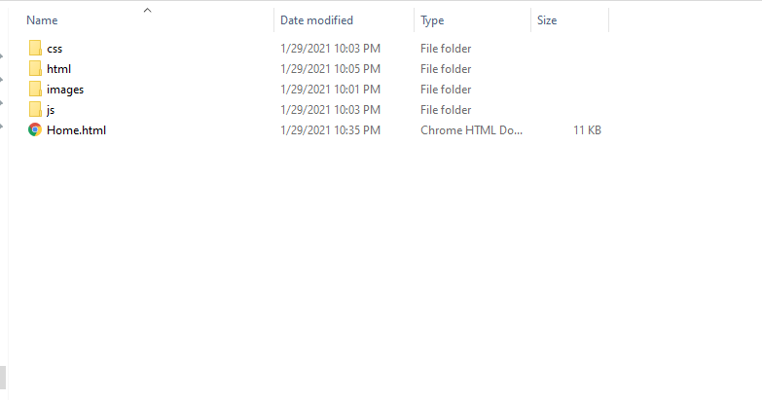

Slide 6
Main Page (Booking Reservation)
A user can reserve a ticket, look at the temperature, and check out the newest and latest deals
The use of forms and tables made it much more illustrious
Javascript made it much more enhancing, and involves user interaction

Slide 7
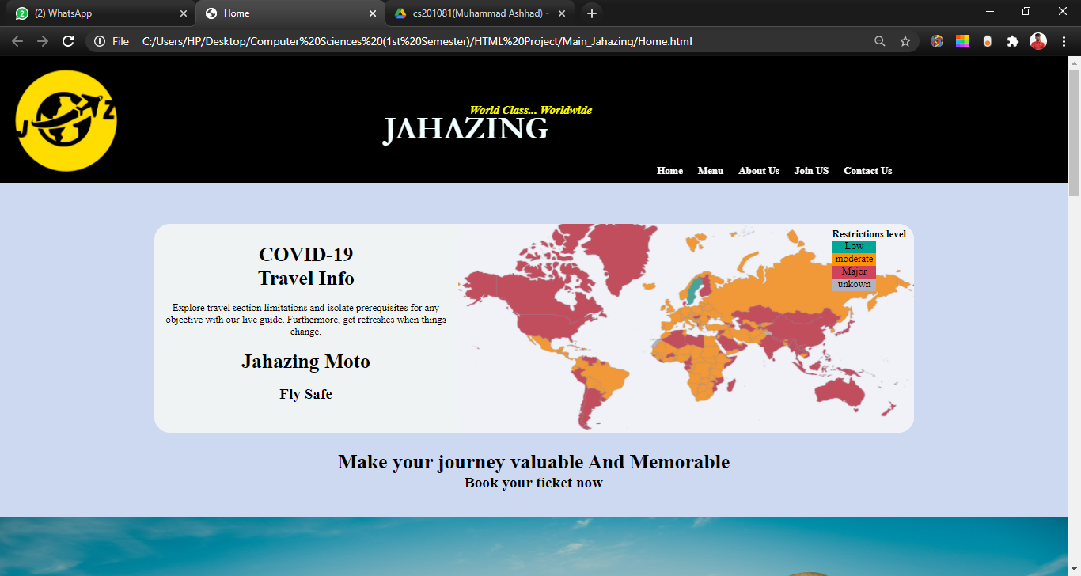

Slide 8
Menu
It serves as a table d’hote menu to the on-flight passengers
User can see the different types of cuisines, foods, and various continental dishes.
We have also used <iframe> to link a Youtube video.
You can also have a brief look at the different pictures of different dishes.

Slide 9
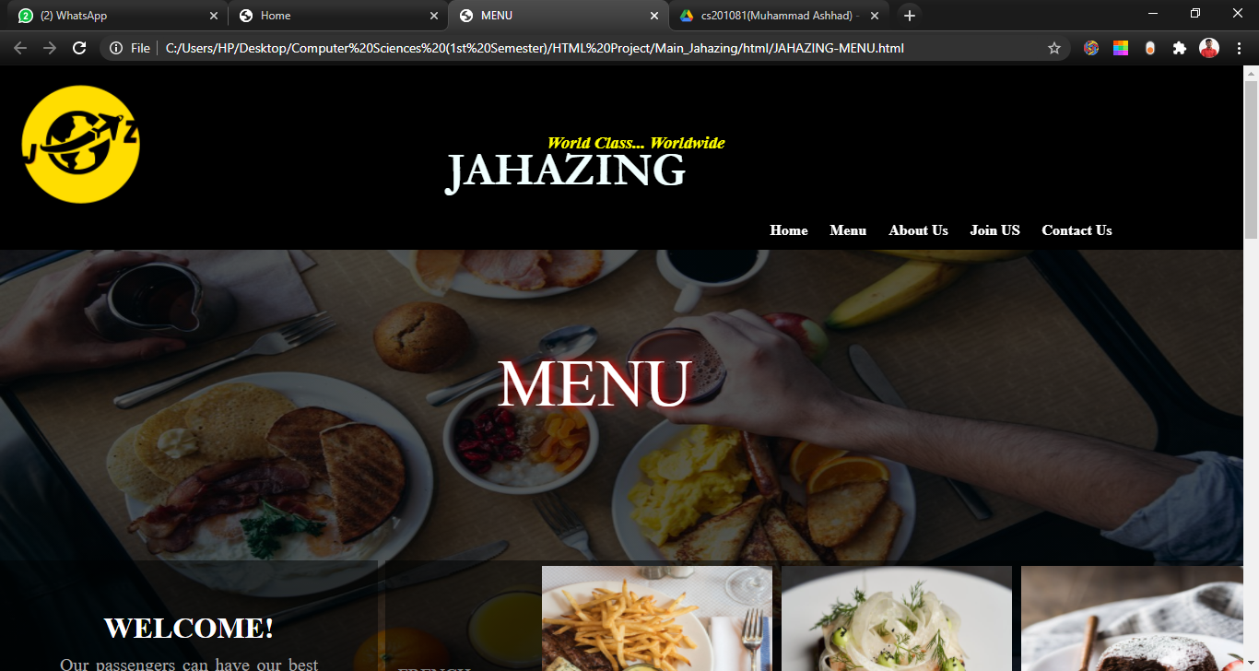

Slide 10
About Us
The user can look at the brief history
We have also placed a GIF to make it much more animating
User can also enter his/her email to subscribe to our newsletter

Slide 11
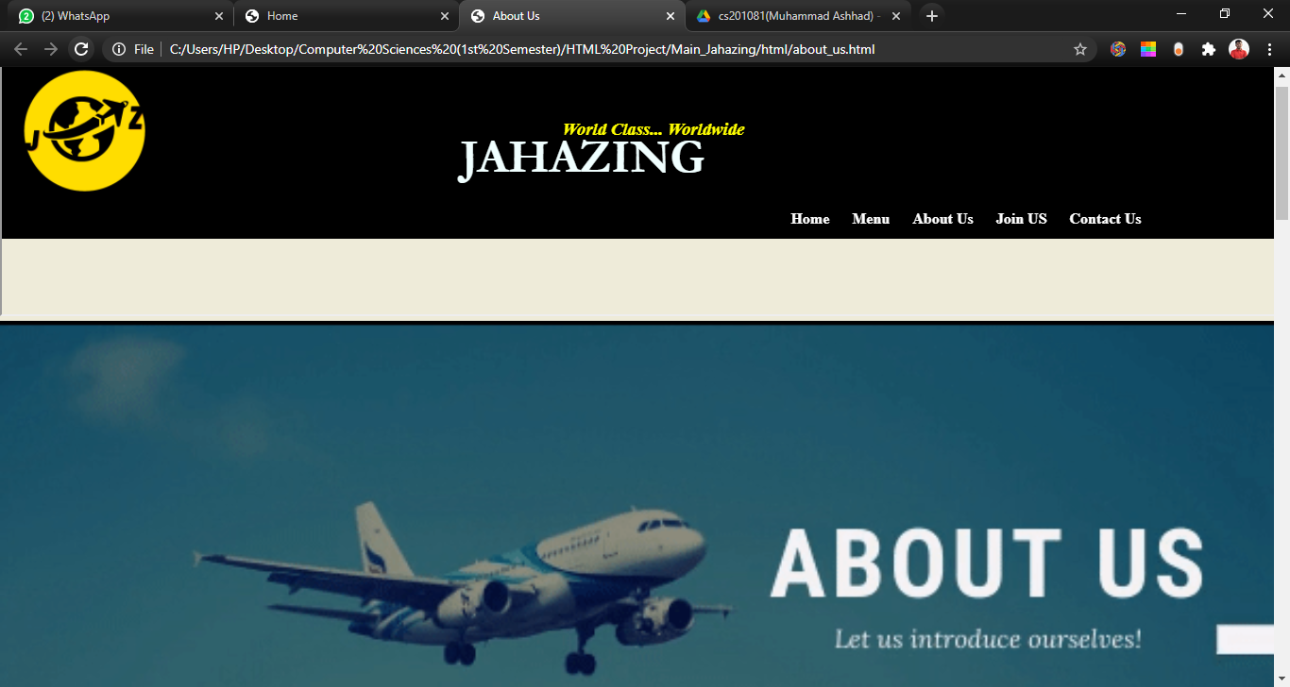

Slide 12
Join Us
This webpage leads to the another webpage that is a form for job application, so that they can join the esteemed airlines
The user can also navigate through the pages, with the different links provided within the webpage
Form validation, link, and other types of javascript events are used over here

Slide 13
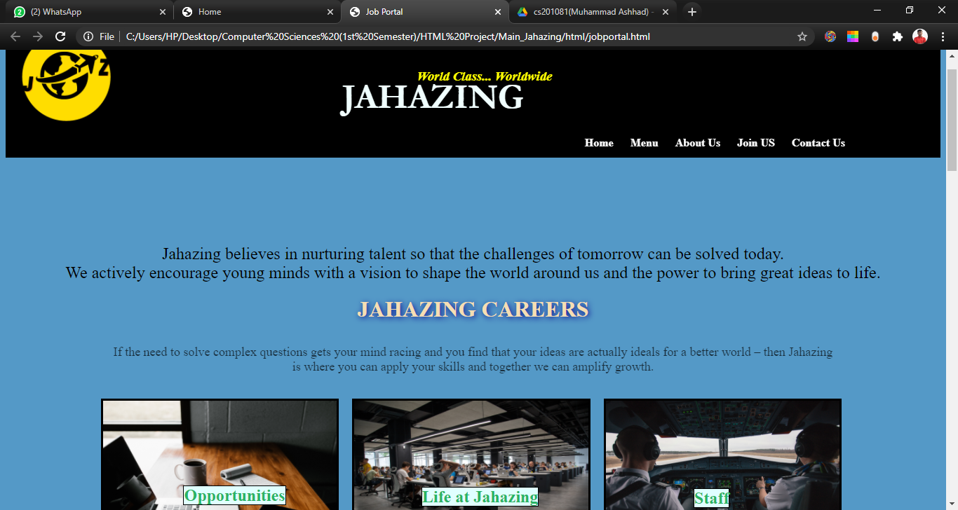

Slide 14
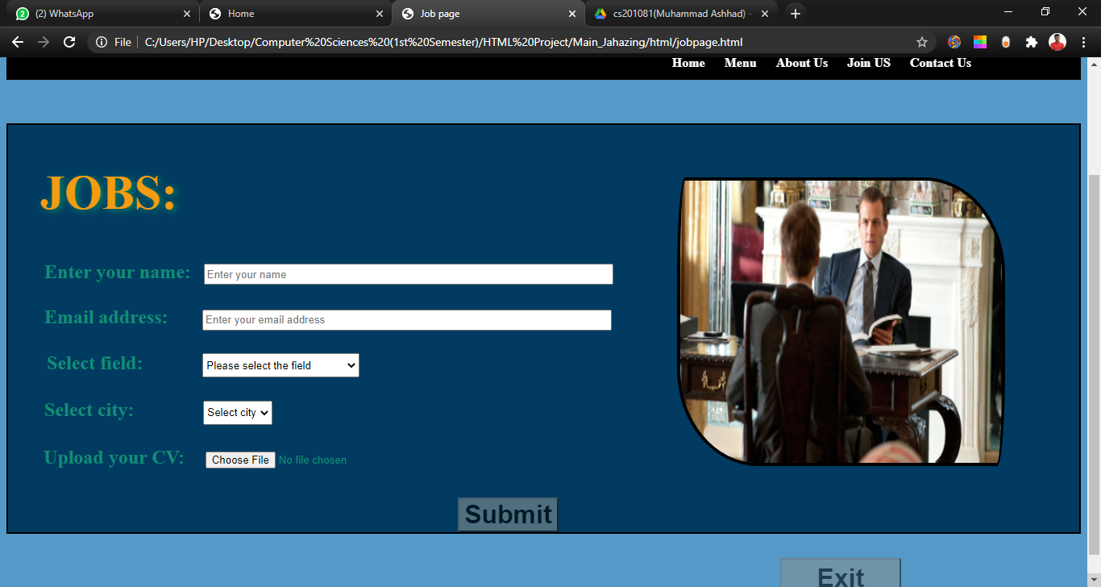

Slide 15
Contact Us
This webpage helps to locate the office
For the sake of simplicity, we have placed the Google Maps tag in the tab.

Slide 16
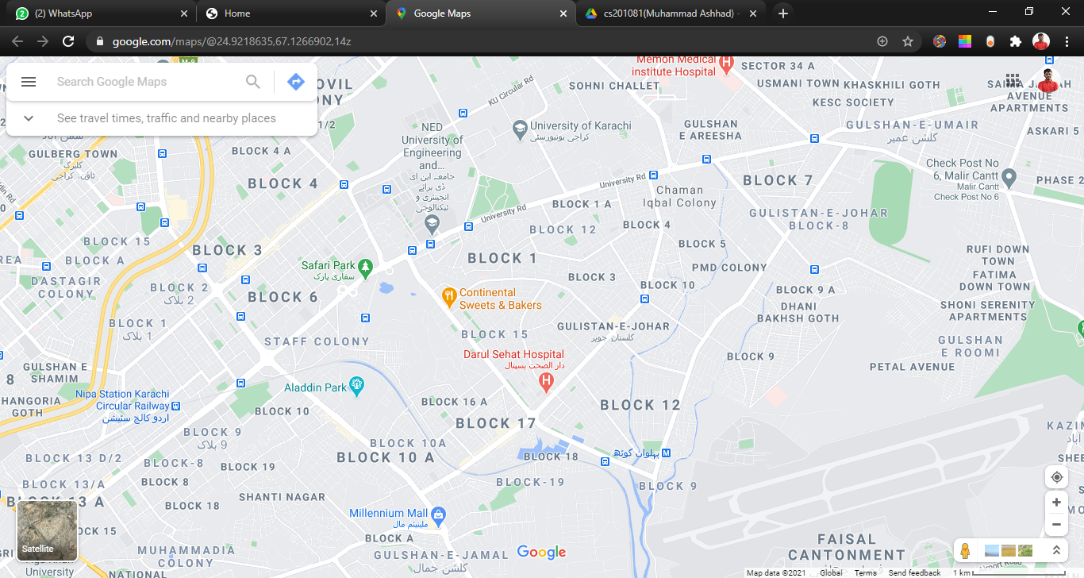

Slide 17


